Slide 1
Probability
Modern AI Models for Vision and Multimodal Understanding
Prof. Tom Yeh

Slide 2
Probabilities

Slide 3
1: Correct, 0: Incorrect
A. How are you?
B. How do you do?
C. Howdy?
D. How are you doing?
E. How is you?
F. How am you?

Slide 4
3: very high, 2: high, 1: low, 0: wrong
A. How are you?
B. How do you do?
C. Howdy?
D. How are you doing?
E. How is you?
F. How am you?

Slide 5
Context: Texas +2
 | A. How are you? | 3
 | B. How do you do? | 2
 | C. Howdy? | 1
 | D. How are you doing? | 3
 | A. How are you? | 3
 | B. How do you do? | 2
 | C. Howdy? | 1
 | D. How are you doing? | 3

Slide 6
Context: Formal +1, Texas +2
 | Texas | A. How are you? | 3
 |  | B. How do you do? | 2
 |  | C. Howdy? | 1
 |  | D. How are you doing? | 3
 | !Texas | A. How are you? | 3
 |  | B. How do you do? | 2
 |  | C. Howdy? | 1
 |  | D. How are you doing? | 3
 | Texas | A. How are you? | 3
 |  | B. How do you do? | 2
 |  | C. Howdy? | 1
 |  | D. How are you doing? | 3
 | !Texas | A. How are you? | 3
 |  | B. How do you do? | 2
 |  | C. Howdy? | 1
 |  | D. How are you doing? | 3

Slide 7
Language Model: Input and Output
L M

Slide 8
Aggregate
Formal | Texas | A. How are you? | 3
 |  | B. How do you do? | 3
 |  | C. Howdy? | 3
 |  | D. How are you doing? | 3
 | !Texas | A. How are you? | 3
 |  | B. How do you do? | 3
 |  | C. Howdy? | 1
 |  | D. How are you doing? | 3
!Formal | Texas | A. How are you? | 3
 |  | B. How do you do? | 2
 |  | C. Howdy? | 2
 |  | D. How are you doing? | 3
 | !Texas | A. How are you? | 3
 |  | B. How do you do? | 2
 |  | C. Howdy? | 1
 |  | D. How are you doing? | 3

Slide 9
Joint probability
Formal | Texas | A. How are you? | 3
 |  | B. How do you do? | 3
 |  | C. Howdy? | 3
 |  | D. How are you doing? | 3
 | !Texas | A. How are you? | 3
 |  | B. How do you do? | 3
 |  | C. Howdy? | 1
 |  | D. How are you doing? | 3
12
22
10
!Formal | Texas | A. How are you? | 3
 |  | B. How do you do? | 2
 |  | C. Howdy? | 2
 |  | D. How are you doing? | 3
 | !Texas | A. How are you? | 3
 |  | B. How do you do? | 2
 |  | C. Howdy? | 1
 |  | D. How are you doing? | 3
10
41
19
9

Slide 10
Conditional probability
Formal | Texas | A. How are you? | 3 | 3/41
 |  | B. How do you do? | 3 | 3/41
 |  | C. Howdy? | 3 | 3/41
 |  | D. How are you doing? | 3 | 3/41
 | !Texas | A. How are you? | 3 | 3/41
 |  | B. How do you do? | 3 | 3/41
 |  | C. Howdy? | 1 | 1/41
 |  | D. How are you doing? | 3 | 3/41
12
22
10
!Formal | Texas | A. How are you? | 3 | 3/41
 |  | B. How do you do? | 2 | 2/41
 |  | C. Howdy? | 2 | 2/41
 |  | D. How are you doing? | 3 | 3/41
 | !Texas | A. How are you? | 3 | 3/41
 |  | B. How do you do? | 2 | 2/41
 |  | C. Howdy? | 1 | 1/41
 |  | D. How are you doing? | 3 | 3/41
10
41
19
9

Slide 11

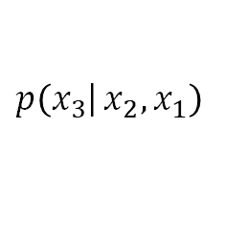
Joint probability
$$p\left(\left.x_{3}\right|{x_{2},x_{1}}\right)$$
$$p\left(x_{1},x_{2},x_{3}\right)$$
Formal | Texas |  |  | A. How are you? | 3 | 3/41 | 3/12
 |  |  |  | B. How do you do? | 3 | 3/41 | 3/12
 |  |  |  | C. Howdy? | 3 | 3/41 | 3/12
 |  |  |  | D. How are you doing? | 3 | 3/41 | 3/12
 | !Texas |  |  | A. How are you? | 3 | 3/41 | 3/10
 |  |  |  | B. How do you do? | 3 | 3/41 | 3/10
 |  |  |  | C. Howdy? | 1 | 1/41 | 1/10
 |  |  |  | D. How are you doing? | 3 | 3/41 | 3/10
12
22
10
!Formal | Texas |  |  | A. How are you? | 3 | 3/41 | 3/10
 |  |  |  | B. How do you do? | 2 | 2/41 | 2/10
 |  |  |  | C. Howdy? | 2 | 2/41 | 2/10
 |  |  |  | D. How are you doing? | 3 | 3/41 | 3/10
 | !Texas |  |  | A. How are you? | 3 | 3/41 | 3/9
 |  |  |  | B. How do you do? | 2 | 2/41 | 2/9
 |  |  |  | C. Howdy? | 1 | 1/41 | 1/9
 |  |  |  | D. How are you doing? | 3 | 3/41 | 3/9
10
41
19
9

Slide 12





Conditional probability
$$p\left(\left.x_{3}\right|{x_{2},x_{1}}\right)$$
$$p\left(x_{1},x_{2}\right)$$
$$p\left(x_{1},x_{2},x_{3}\right)$$
Formal | Texas |  |  | A. How are you? | 3 | 3/41 | 3/12
 |  |  |  | B. How do you do? | 3 | 3/41 | 3/12
 |  |  |  | C. Howdy? | 3 | 3/41 | 3/12
 |  |  |  | D. How are you doing? | 3 | 3/41 | 3/12
 | !Texas |  |  | A. How are you? | 3 | 3/41 | 3/10
 |  |  |  | B. How do you do? | 3 | 3/41 | 3/10
 |  |  |  | C. Howdy? | 1 | 1/41 | 1/10
 |  |  |  | D. How are you doing? | 3 | 3/41 | 3/10
$$\frac{12}{41}$$
12
$$\frac{10}{41}$$
22
10
!Formal | Texas |  |  | A. How are you? | 3 | 3/41 | 3/10
 |  |  |  | B. How do you do? | 2 | 2/41 | 2/10
 |  |  |  | C. Howdy? | 2 | 2/41 | 2/10
 |  |  |  | D. How are you doing? | 3 | 3/41 | 3/10
 | !Texas |  |  | A. How are you? | 3 | 3/41 | 3/9
 |  |  |  | B. How do you do? | 2 | 2/41 | 2/9
 |  |  |  | C. Howdy? | 1 | 1/41 | 1/9
 |  |  |  | D. How are you doing? | 3 | 3/41 | 3/9
$$\frac{10}{41}$$
10
$$\frac{9}{41}$$
41
19
9

Slide 13

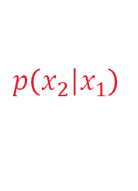




Probability
$$p\left(\left.x_{2}\right|x_{1}\right)$$
$$p\left(\left.x_{3}\right|{x_{2},x_{1}}\right)$$
$$p\left(x_{1},x_{2}\right)$$
$$p\left(x_{1},x_{2},x_{3}\right)$$
Formal |  | Texas |  |  | A. How are you? | 3 | 3/41 | 3/12
 |  |  |  |  | B. How do you do? | 3 | 3/41 | 3/12
 |  |  |  |  | C. Howdy? | 3 | 3/41 | 3/12
 |  |  |  |  | D. How are you doing? | 3 | 3/41 | 3/12
 |  | !Texas |  |  | A. How are you? | 3 | 3/41 | 3/10
 |  |  |  |  | B. How do you do? | 3 | 3/41 | 3/10
 |  |  |  |  | C. Howdy? | 1 | 1/41 | 1/10
 |  |  |  |  | D. How are you doing? | 3 | 3/41 | 3/10
$$\frac{12}{41}$$
$$\frac{12}{22}$$
12
$$\frac{10}{41}$$
$$\frac{10}{22}$$
22
10
!Formal |  | Texas |  |  | A. How are you? | 3 | 3/41 | 3/10
 |  |  |  |  | B. How do you do? | 2 | 2/41 | 2/10
 |  |  |  |  | C. Howdy? | 2 | 2/41 | 2/10
 |  |  |  |  | D. How are you doing? | 3 | 3/41 | 3/10
 |  | !Texas |  |  | A. How are you? | 3 | 3/41 | 3/9
 |  |  |  |  | B. How do you do? | 2 | 2/41 | 2/9
 |  |  |  |  | C. Howdy? | 1 | 1/41 | 1/9
 |  |  |  |  | D. How are you doing? | 3 | 3/41 | 3/9
$$\frac{10}{41}$$
$$\frac{10}{19}$$
10
$$\frac{9}{41}$$
$$\frac{9}{19}$$
41
19
9

Slide 14
The Chain Rule of Probabilities

Slide 15
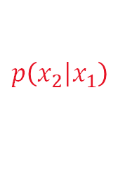

Conditional → Joint Probabilities
$$p\left(\left.x_{3}\right|{x_{2},x_{1}}\right)$$
$$p\left(\left.x_{2}\right|x_{1}\right)$$
$$p\left(x_{1}\right)$$
$$p\left(x_{1},x_{2}\right)$$
$$p\left(x_{1},x_{2},x_{3}\right)$$
Formal |  | Texas |  |  | A. How are you? | 3 | 3/41 | 3/12
 |  |  |  |  | B. How do you do? | 3 | 3/41 | 3/12
 |  |  |  |  | C. Howdy? | 3 | 3/41 | 3/12
 |  |  |  |  | D. How are you doing? | 3 | 3/41 | 3/12
 |  | !Texas |  |  | A. How are you? | 3 | 3/41 | 3/10
 |  |  |  |  | B. How do you do? | 3 | 3/41 | 3/10
 |  |  |  |  | C. Howdy? | 1 | 1/41 | 1/10
 |  |  |  |  | D. How are you doing? | 3 | 3/41 | 3/10
$$\frac{12}{41}$$
$$\frac{12}{22}$$
12
$$\frac{10}{41}$$
$$\frac{10}{22}$$
22
10

Slide 16
Tree Representation
A | 0.25
B | 0.25
C | 0.25
D | 0.25
Y
N
A | 0.3
B | 0.3
C | 0.1
D | 0.3
Y
N
A | 0.3
B | 0.2
C | 0.2
D | 0.3
Y
N
A | 0.33
B | 0.22
C | 0.11
D | 0.33

Slide 17



Probability Distribution vs. Values
$P\left(x_{1}\right)$ =
Y | 0.54
N | 0.46
$P\left(x_{1}=Y\right)$ =
$P\left(x_{1}=N\right)$ =

Slide 18


Conditional Probability Distributions
$P\left(x_{2} |x_{1}=Y\right)$ =
Y | 0.55
N | 0.45
Y | 0.54
N | 0.46
$$P\left(x_{2} |x_{1}=N\right)=$$
Y | 0.53
N | 0.47

Slide 19
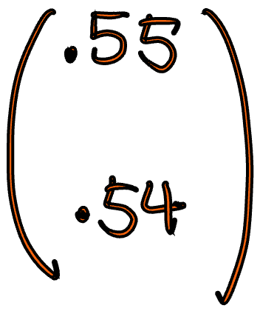
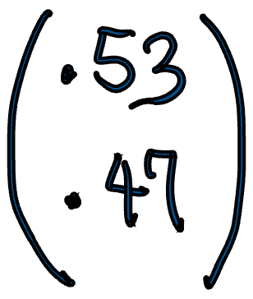


Conditional Probability Values
$P\left(x_{2} |x_{1}=Y\right)$ =
$$P\left(x_{2}=Y|x_{1}=Y\right)=$$
Y | 0.55
N | 0.45
Y | 0.54
N | 0.46
$$P\left(x_{2} |x_{1}=N\right)=$$
$$P\left(x_{2}=N|x_{1}=N\right)=$$
Y | 0.53
N | 0.47

Slide 20


Joint Probability “Values” by the Chain Rule
Joint Probability of x1, x2
= p(________, ________)
= p(__________) x p(__________)
Y | 0.55
N | 0.45
Y | 0.54
N | 0.46
$P\left(x_{1}=Y,x_{2}=N \right)$ =
Y | 0.53
N | 0.47
$P\left(x_{1}=N,x_{2}=Y \right)$ =

Slide 21


Joint Probability “Distributions” by the Chain Rule
Y | 0.55
N | 0.45
$P\left(x_{1}=Y,x_{2} \right)$ =
Y | 0.54
N | 0.46
Y | 0.53
N | 0.47
$P\left(x_{1}=N,x_{2}\right)$ =

Slide 22


Conditional Probability Distributions
A | 0.25
B | 0.25
C | 0.25
D | 0.25
$$P\left(x_{3} |x_{1}=N,x_{2}=Y\right)=$$
Y | 0.55
N | 0.45
A | 0.3
B | 0.3
C | 0.1
D | 0.3
Y | 0.54
N | 0.46
A | 0.3
B | 0.2
C | 0.2
D | 0.3
$$P\left(x_{3} |x_{1}=Y,x_{2}=N\right)=$$
Y | 0.53
N | 0.47
A | 0.33
B | 0.22
C | 0.11
D | 0.33

Slide 23
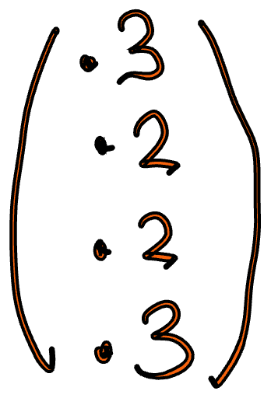
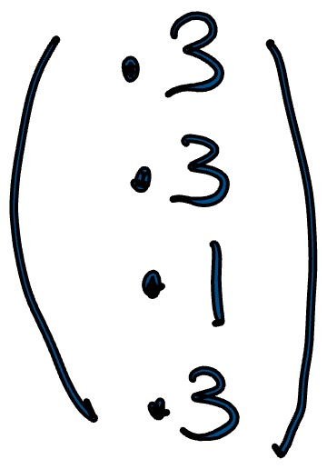




Conditional Probability Values
A | 0.25
B | 0.25
C | 0.25
D | 0.25
$$P\left(x_{3} |x_{1}=N,x_{2}=Y\right)=$$
Y | 0.55
N | 0.45
$$P\left(x_{3}=C |x_{1}=N,x_{2}=Y\right)=$$
A | 0.3
B | 0.3
C | 0.1
D | 0.3
Y | 0.54
N | 0.46
$$P\left(x_{3} |x_{1}=Y,x_{2}=N\right)=$$
A | 0.3
B | 0.2
C | 0.2
D | 0.3
$$P\left(x_{3}=D |x_{1}=Y,x_{2}=N\right)=$$
Y | 0.53
N | 0.47
A | 0.33
B | 0.22
C | 0.11
D | 0.33

Slide 24


Joint Probability “Values” by the Chain Rule
A | 0.25
B | 0.25
C | 0.25
D | 0.25
Joint Probability of x1, x2, x3
= p(________, ________, ________)
= p(__________) x p(__________) x p(__________)
Y | 0.55
N | 0.45
A | 0.3
B | 0.3
C | 0.1
D | 0.3
Y | 0.54
N | 0.46
A | 0.3
B | 0.2
C | 0.2
D | 0.3
$P\left(x_{1}=Y,x_{2}=N,x_{3}=A\right)$ =
Y | 0.53
N | 0.47
A | 0.33
B | 0.22
C | 0.11
D | 0.33
$P\left(x_{1}=N,x_{2}=N,x_{3}=B\right)$ =

Slide 25

Joint Probability “Distributions” by the Chain Rule
A | 0.25
B | 0.25
C | 0.25
D | 0.25
Y | 0.55
N | 0.45
A | 0.3
B | 0.3
C | 0.1
D | 0.3
$P\left(x_{1}=Y,x_{2}=N,x_{3}\right)$ =
Y | 0.54
N | 0.46
A | 0.3
B | 0.2
C | 0.2
D | 0.3
Y | 0.53
N | 0.47
A | 0.33
B | 0.22
C | 0.11
D | 0.33

Slide 26
Pixel-based Image Model

Slide 27
Color Image
C | C | B | A
B | B | B | A
B | C | B | A
B | B | B | B

Slide 28
Part Labels
1 = skin, 2 = hair
2 | 2 | 2 | 1
1 | 1 | 1 | 2
1 | 1 | 1 | 1
1 | 1 | 1 | 1

Slide 29
Generative Image Model (Joint Probability)
1 = skin, 2 = hair
C | C | B | A
B | B | B | A
B | C | B | A
B | B | B | B
2 | 2 | 2 | 1
1 | 1 | 1 | 2
1 | 1 | 1 | 1
1 | 1 | 1 | 1

Slide 30
Tree Representation
1 = skin, 2 = hair
C | C | B | A
B | B | B | A
B | C | B | A
B | B | B | B
2 | 2 | 2 | 1
1 | 1 | 1 | 2
1 | 1 | 1 | 1
1 | 1 | 1 | 1

Slide 31
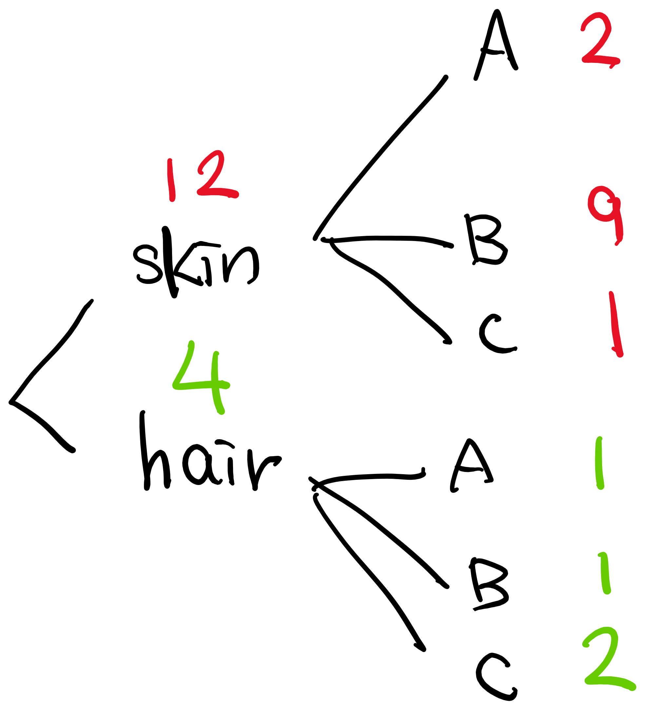
Conditional Probability Distribution
p( color | part = skin) =
p( color | part = hair) =

Slide 32
Conditional Probability Values
p( color = A | part = skin) =
p( color = B | part = hair) =

Slide 33
Joint Probability Distribution
p( color, part = skin) =
p( color, part = hair) =

Slide 34
Joint Probability Values
p( color = A, part = skin) =
p( color = B, part = hair) =

Slide 35
Autoregressive Image Model

Slide 36
What to draw next?

Slide 37
Sketch Tree

Slide 38


Conditional Probability
p( | )=
p( x4| )=
p( | )=
p( x4| )=

Slide 39




Joint Probability
p( )=
p( )=
p( )=
p( )=

